Slide 1
Data Analysis
Roll Forward Rates
-
- Roll rate for TBO loans in March: 60.9%
Roll rate for TB0 loans in April: 67.1%
Roll rate for TB0 loans in May: 72.1%
Roll rate for March TB0 loans: 1.591%
Roll rate for April TB0 loans: 1.998%
Roll rate for May TB0 loans: 1.556%
Principal Balance Roll forward rate:
Total sanctioned amount: 1862351670144
Balance roll rate for TB0 loans in March: 44.4 %
Balance roll rate for TB0 loans in April: 48.56 %
Balance roll rate for TB0 loans in May: 53.39 %
 | Roll Forward Rate | Principal Balance Roll Forward | Principal Balance Roll Forward Rate
MONTH
March | 60.921 | $ 827,728,346,975.54 | 44.445
April | 67.129 | $ 904,446,972,331.73 | 48.565
May | 72.176 | $ 994,376,841,007.47 | 53.394

Slide 2
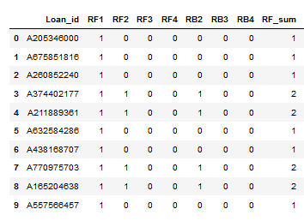
Data Analysis
QC Checks & Issues
Call Data Analysis
 | Average Intensity | Average RPC Rate | Average PTP Rate
MONTH
March | 12.958 | 0.495 | 0.237
April | 11.248 | 0.485 | 0.218
May | 10.963 | 0.497 | 0.215
 |  | No. of Months | RPC | PTP | Total Contacts | RPC rate | PTP rate | Perf Metric
TOP 5 | Login_ID
 | AGNT91 | 2 | 7 | 2 | 7 | 1.000 | 0.287 | 0.584
 | AGNT58 | 1 | 2 | 1 | 2 | 1.000 | 0.505 | 0.515
 | AGNT79 | 2 | 9 | 8 | 17 | 0.529 | 0.471 | 0.508
 | AGNT80 | 2 | 9 | 2 | 9 | 1.000 | 0.223 | 0.456
 | AGNT71 | 1 | 4 | 4 | 6 | 0.667 | 0.668 | 0.456
BOTTOM 5 | Login_ID
 | AGNT68 | 2 | 81 | 0 | 81 | 1.000 | 0.000 | 0.010
 | AGNT75 | 1 | 13 | 0 | 14 | 0.929 | 0.001 | 0.011
 | AGNT104 | 1 | 12 | 0 | 12 | 1.000 | 0.001 | 0.011
 | AGNT51 | 1 | 7 | 0 | 7 | 1.000 | 0.001 | 0.011
 | AGNT83 | 3 | 9 | 0 | 9 | 1.000 | 0.001 | 0.013
Correlation between principal balance and term: -0.551402
If we estimate the absolute correlation value as being moderate if it falls between 0.5 and 0.7, we can conclude that there is a moderate correlation between term completed and principal balance. In addition as this is a negative value, we conclude that this is a negative relationship, meaning as there is an increase in one variable there is a decrease in the other and vice-versa.

Slide 3
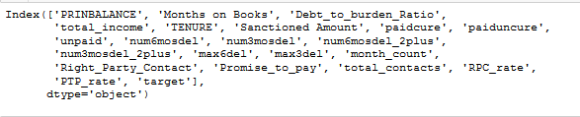
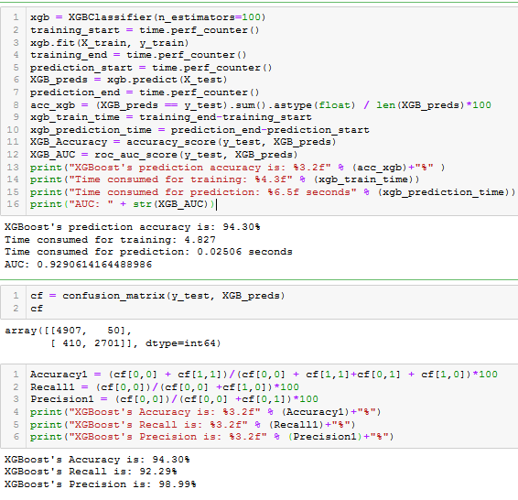
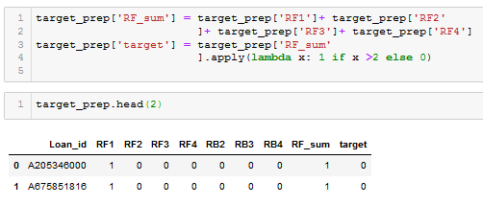
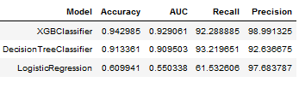
Prediction Model
XGB Classifier
Features
Target
LR & DT Result Comparison

Slide 4
Post Mortem
Dataset Limitations and Issues
Some Observations...
Several factors with respect to the dataset and methodology need to be carefully considered in light of client’s credit outlook and any regulatory requirements:
Details of loan balance and payments (interest/principal split) , pricing and default penalties...
Definition, methodology and timing for loan roll-backs and roll-forward ...
QC and revalidation of 6 monthly data particularly rollb and rolf...
Historical data for agent calls and responses as well and link back to results (rollb/forward)...
Definition and features of target variable in light of the sampling methodology...
Calibration of prediction model in light of tabove factors and he risk policies of client and portfolio risk considerations...
Current analysis and modelling is overly dependant on dataset limitations and assumptions...
Current target definition has been calibrated in line with broad portfolio of models (XGB / DT / LR) and needs to be optimized for final model choice...
Further room for feature engineering based on discussion and additional data...
Choice of final modelling methodology needs to be considered further...

Slide 5
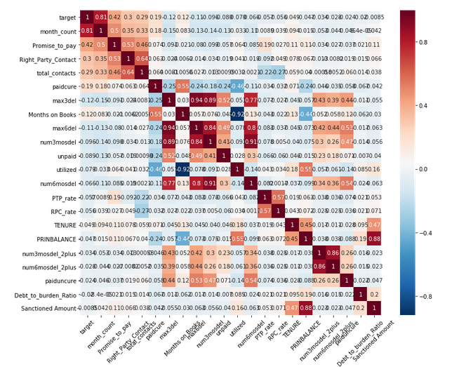
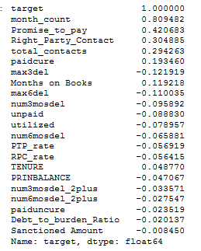
Appendix: Additional Discussion Materials
Correlation Heat Map

